Slide 1

BOTASTRA- Group 16 A
Name- Aryan Kumar
Admission Number- 21JE0176

Slide 2
PROBLEM STATEMENTs

Slide 3
You are very fond of music. So, you have kept two speakers, one in the room and one in the lawn. To save electricity, you want the speaker near to you to play the music, while the other one should stop immediately, and even control the loudness of the music as you move nearer or far, since listening to loud music can harm your ears. Also, you should maintain the brightness of the bulb in the room and the lawn according to the brightness of the surroundings. Keeping in mind to keep your solution as economical as possible, design a system as mentioned above to save electricity by using only one speaker and one LED at a time.

Slide 4
Approach To The Problem

Slide 5
We will discuss the approach as we progress through the slides. Arduino Uno, a microcontroller board, is to be used for carrying out logic computation. Further, we make note of the following point from the problem statement:
Two sets of inputs are needed:
My location with respect to the two speakers: ultrasonic sensors are to be used for obtaining this information
Brightness of the surroundings: a photodiode is to be used for obtaining this information
Also, a permanent storage solution would be needed for storing the music file to be played using Arduino. This is because Arduino Uno only has an extremely limited permanent memory prebuilt with it. In this project, we use an external SD card as the storage solution.

Slide 6
Components REQUIRED and Software Used

Slide 7
Software Used | Description
Arduino IDE | For testing certain parts of the code
Fritzing | For creating the image file for the circuit diagram
Auto Tinkercad and Wokwi | for running some Arduino simulations
Software

Slide 8
For ease, we will divide the Components required for this project into four different categories:
Basic
Input devices
Output devices
Storage devices
Component Required | Quantity | Description
Arduino Uno (Rev3) | 1 | Arduino Uno is a microcontroller board based on the ATmega328P. The ATmega328P is the brain of our project!
N-Channel MOSFETs | 2 | Used in amplifying the signals from Arduino for controlling our LEDs
10KΩ Resistors | 3 | Pull-up resistors
Connecting Wires
1. BASIC

Slide 9
These Components will fetch the required inputs for us to work upon
2. Input devices
Component Required | Quantity | Description
Ultrasonic Distance Sensor (HC-SR04) | 2 | For obtaining information about my location with respect to the bot
Si Photodiode (S1133) | 1 | For obtaining information about the brightness of light in my surroundings

Slide 10
The Input devices control the output of these Components
3. Output devices
Component Required | Quantity | Description
12V LED Strips | 2 | Give me some rays!!
8Ω Speakers | 2 | For playing my favorite music😋😋

Slide 11
For storing/accessing my favorite music
4. Storage devices
Component Required | Quantity | Description
Any micro SD card with <= 16GB capacity | 1 | The SD card will contain all my favorite songs in a single .wav file
Micro SD card module for Arduino | 1 | For retrieving my song stored in the SD card

Slide 12
CIRCUIT DIAGRAM

Slide 13
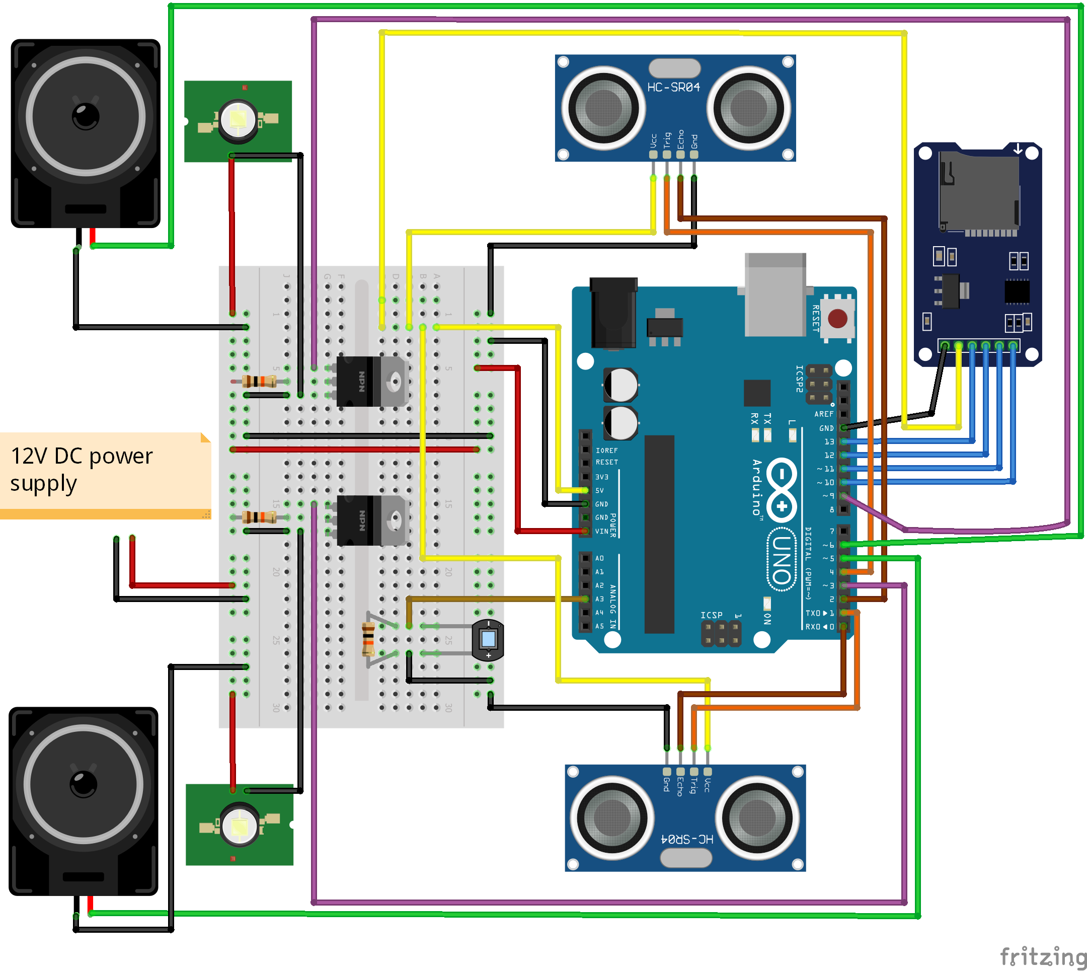
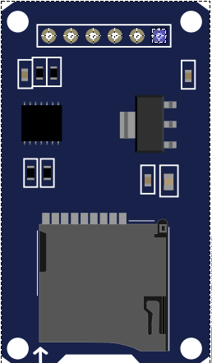
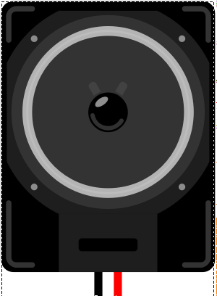
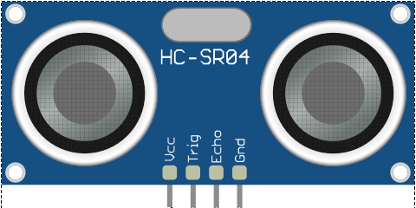
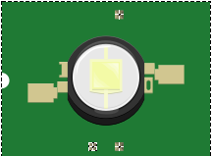

SD Card Module
SPEAKER
12V LED
Ultrasonic sensor
Photodiode

Slide 14
LED
Ultrasonic sensor
Setup 1: setup kept in the room
Door
Speaker
A similar setup will be kept in the lawn. Let’s call that setup 2.

Slide 15
Note that any of the above device connections for information exchange with the Arduino board can be made to any of the digital/analog pins on the board, except for the following:
The MOSI, MISO, and SCK pins of the Arduino SD card module have to be connected to 11, 12, 13 pins of the Arduino Uno
The signals sent by photodiode can only be read by an analog input pin
The signals for the speakers can only be sent through PWM capable digital output pins
The signals for the LEDs can only be sent through PWM capable digital output pins

Slide 16
PSEUDO CODE

Slide 17
FIRST, SOME BASIC STUFF…
We ask the compiler to import some libraries (like SPI.h, SD.h, TMRPCM.h) which would be required for our code.
Also, we initialize the following global variables:
Two float variables for storing my distance (in cm) from the two sensors
An int variable for storing the information received from the photodiode about the intensity of light in my surroundings. The photodiode will provide the information in numbers from 0 to 1023.
Two tmrpcm objects, which contain functions for playing my song

Slide 18
setting Things up: Void Setup()
We now set the pins of the Arduino to either read mode or write mode as per the circuit diagram:
Pins 0, 2, A3 are set to read data
Pins 1, 3, 4, 9 are set to write data
We dictate the computer to note the pins connected to the two speakers (in our case, pins 5 and 6) using a function of the two tmrpcm objects we initialized earlier. Each object is thus, assigned for playing music in one of the two speakers.
We also notify these objects to note the .wav file containing my songs.
The playback of music is started in both the speakers using a function in these objects. Let the party begin!!

Slide 19
Controlling the Speakers/LEDs: Void Loop()
First, we will need to get the information about my distance from the two setups using the ultrasonic sensors.
An ultrasonic sensor works by sending an ultrasonic wave pulse through its transmitter when it is triggered using its trigger pin. At the same time, its receiver starts waiting for the wave to strike a nearby obstacle and reflect back to the sensor.
When the receiver detects the reflected wave, it communicates to Arduino through the echo pin of the ultrasonic sensor. The time elapsed between the creation of the wave and its return back to the sensor gives the information about the required distance.

Slide 20

Now back to what we do through this function…
We trigger an ultrasonic sensor. This is done by setting its trigger pin to high using the digitalWrite() function.
We then wait for 10μs before setting the trigger pin to low again. This action generates a pulse of 8 ultrasonic waves. Also, it sets its echo pin to high. (Note that in our setup, the trigger pins for the two sensors are 0 and 2).
The receiver listens for the wave to reflect back to the sensor. When successful, it notifies the Arduino by setting the Echo pin to low again. The time (in μs) spent in the process is measured using the pulseIn() function. (Note that in our setup, the trigger pins for the two sensors are 1 and 4). The distance (in cm) between myself and an ultrasonic sensor is thus calculated using the formula:
DISTANCE $=\frac{\text{0.034} × \text{D}\text{URATION}}{\text{2}}$
and stored in the global variable we defined for the purpose earlier.
This process is repeated for the other ultrasonic sensor.

Slide 21
Next up, we determine the intensity of the light in the surroundings by reading the data from the photodiode connected to an analog pin of Arduino (in our case, the pin is A3). The data is read using the analogRead() function and stored in the global variable defined for the purpose.
Now we proceed according to the following if-then logic:

Slide 22
IF |  | THEN
Distance from Setup 1 | Distance from Setup 2 | Volume of Speaker in Setup 1 | Volume of Speaker in Setup 2
<250cm | >250cm | TBD according to my distance from setup 1 | 0
>250cm | <250cm | 0 | TBD according to my distance from setup 2
<250cm | <250cm | The setup nearer to me plays the music with volume decide by the distance between me and the setup. The other speaker is put at 0 volume.
>250cm | >250cm | 0 | 0

Slide 23
LED
Ultrasonic sensor
Door
Speaker
250 cm

Slide 24
IF |  | THEN
Distance from Setup 1 | Distance from Setup 2 | Brightness of LED in Setup 1 | Brightness of LED in Setup 1
<250cm | >250cm | TBD according to data from photodiode | 0
>250cm | <250cm | 0 | TBD according to data from photodiode
<250cm | <250cm | The setup nearer to me has the LED turned on with its brightness decided by the data from photodiode. The other LED is put at 0 brightness.
>250cm | >250cm | 0 | 0

Slide 25
The volume of the speakers is controlled using a function in those twrpcm objects we defined earlier.
The brightness of the LED lights is controlled by changing the duty cycle of the PWM signals sent to them (in our case, through pins 3 and 9). Arduino is instructed to effect this change using the analogWrite() function. 256 different levels of the duty cycle of the PWM signal can be set, from 0 through 255.
This part of the program, which controls the speakers and the LEDs (written as the void loop() function) runs in an unconditional loop. The loop continues executing till the Arduino is turned off or is reset.

Slide 26
Problems faced

Slide 27
LED lights: The typical LED bulbs at our homes draw somewhat close to 10 watts of power. However, the power supplied through the pins of Arduino is minimal (max. voltage draw- 10V, max current draw from a single pin- 40mA). Therefore, these high-power LEDs could not be connected directly to Arduino, and an external power supply was needed them. But then again, we needed the information about the required brightness of the LEDs from the Arduino itself.
Ultrasonic sensors: These sensors work on the principle of creating and receiving back waves. Thus, they lack the ability to differentiate between obstacles that reflect these waves. Also, the effective range of these sensors is limited (~400-450m).
Permanent storage: Arduino Uno does not have inbuilt permanent storage capable of storing a music file.
Options for music playback through Arduino are few.

Slide 28
Takeaway and References

Slide 29
Arduino is a great bot-building platform for beginners like me. However, as the projects start to get complicated, even Arduino becomes increasingly difficult to use. Apart from Roboism workshops, I primarily referred to the following sites for information:
freeCodeCamp.org channel on YouTube: for the coding part of the project
Foundations | Arduino
Arduino Projects Hub
Arduino Docs
Arduino Forum
Adafruit Learning System
Last Minute Engineers
Banner Engineering
Maker Pro | Electronics Projects and Tutorials
SparkFun Electronics
tutorialspoint
Circuit Digest

